Slide 1
Increasein

Slide 4
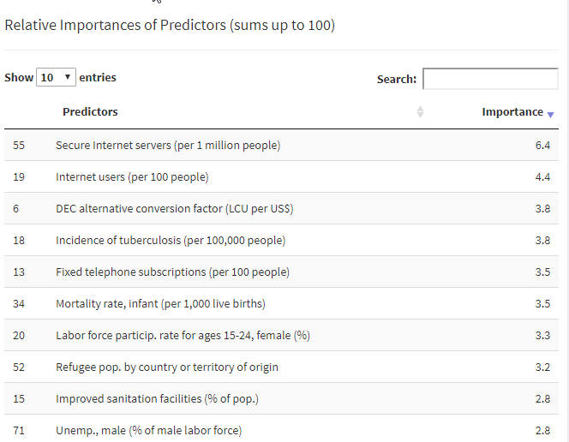

Slide 5
Appendix

Slide 6
About World Happiness Score and World Development Indicators
WHR has was published in 2012, 2013, 2015, and 2016
World Happiness Scores:
Used regularly by the World Happiness Report.
The actual happiness scores and rankings come from the Gallup World Poll.
The exact wording of the “happiness” question is:
“Please imagine a ladder, with steps numbered from 0 at the bottom to 10 at the top. The top of the ladder represents the best possible life for you and the bottom of the ladder represents the worst possible life for you. On which step of the ladder would you say you personally feel you stand at this time?”
This app used the World Happiness Scores and rankings for 2015 posted on Kaggle.
World Development Indicators:
Are collected and published yearly by the World Bank.
This app used the data on 74 indicators from 1993 to 2014 posted on Kaggle.

Slide 8
World Happiness Report

